Slide 1
Absolute & Comparative Advantage

Slide 2
Absolute & Comparative Advantage
    Absolute advantage: refers to the ability of a country to produce a good using fewer resources than another country
    Comparative advantage: arises when a country has a lower relative cost, or opportunity cost, in the production of a good than another country.
    Theory of absolute advantage: if countries specialize in and export the good in which they have an absolute advantage, the result is increased production and consumption in each country.
    Theory of comparative advantage: as long as opportunity costs in two or more countries differ, it is possible for all countries to gain from specialization and trade according to their comparative advantage.

Slide 3
Law of Absolute Advantage
    Example; Consider a simple world economy of two countries Coffenia and Robotica, that produce coffee and robots
        Under autarky, assume that each worker in Coffenia and Robotica allocate their time evenly between production of robots and coffee
        Suppose that the countries would trade 1 coffee: 1 robot and that 3 units are traded
 | Coffee or Robots (Production) |  | Autarky (Production) |  | Specialization (Production) |  | Specialization (Consumption)
 | Coffee | Robots | Coffee | Robots | Coffee | Robots | Coffee | Robots
Coffenia | 8 | 4 | 4 | 2 | 8 | 0 | 5 | 3
Robotica | 3 | 6 | 1.5 | 3 | 0 | 6 | 3 | 3
Total | − | − | 5.5 | 5 | 8 | 6 | 8 | 6

Slide 4
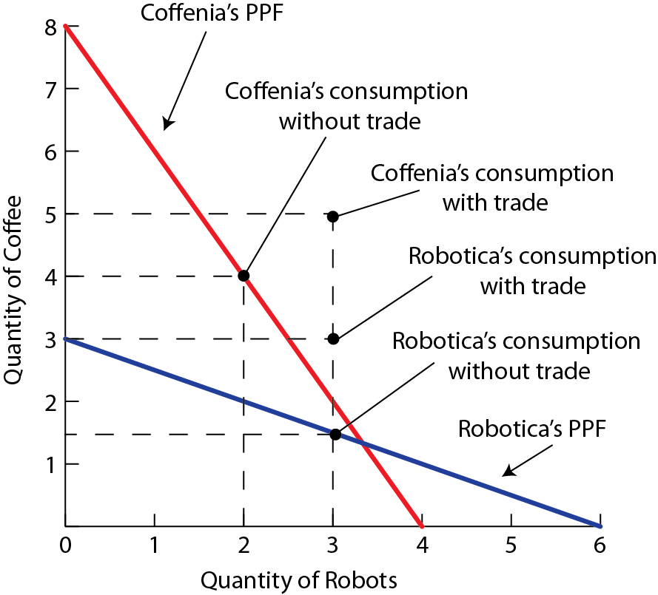
    Originally, both countries were producing on their PPF
        Trade allows countries to consume at a point outside of their PPF
        Specialization increases production by 2.5 units of coffee and 1 robot
    Specialization according to absolute advantage leads to a global reallocation of resources where production takes place by the most efficient producers

Slide 5
Law of Comparative Advantage
    Example; Consider a simple world economy of two countries Cottonia and Microchippia, producing cotton and microchips.
    Suppose that the countries trade 1 cotton: 1 microchip and that 10 units are traded
    Since Cottonia has a lower opportunity cost in the production of cotton the country would specialize in cotton production
        Cottonia would export cotton and import microchips
 | Cotton or Microchips (Production) |  | Cotton (Opportunity Cost) | Microchips (Opportunity Cost)
 | Cotton | Microchips
Cottonia | 20 | 10 | 10 ÷ 20 = 0.5 | 20 ÷ 10 = 2
Microchippia | 25 | 50 | 50 ÷ 25 = 2 | 25 ÷ 50 = 0.5

Slide 6
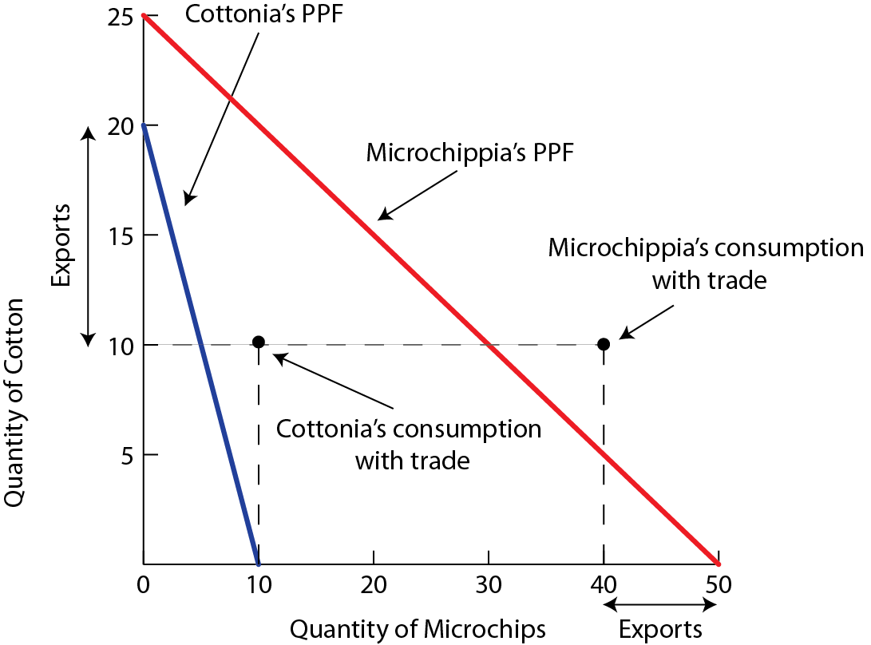
    Microchippia has a lower opportunity cost in the production of microchips and would specialize in microchip production
        Microchippia would export microchips and import cotton
    Trade allows both countries to consume at a point outside of their PPF

Slide 7
Summary
    The country that has the flatter PPF has a comparative advantage in the good measured on the horizontal axis
    The country that has the steeper PPF has a comparative advantage in the good measured on the vertical axis

